Slide 1

Capstone Project: Office Supplies Campaign sales
By Michael Ayedun

Slide 2
Table of Contents
Background
Objectives
Methodology
EDA
Data Analysis
Findings
Recommendations

Slide 3
Background:
About 16,000 existing customers were targeted to tests a telemarketing campaign that consists of the selling of office supplies. Which produced real world data that recorded the information and transaction activity between the customers
The goals for this campaign:
Identify which customers are likely to make a purchase
Which type of customers will generate the most profit
The expected amount of profit to be made in regards to the campaign

Slide 4


Objective:
Create a model to calculate the expected profit that the company should expect to make from the campaign.
Identify the usual customers for the office supply company
Highlight priority Customers that are likely to respond and make purchases from the Office Supply Campaign.
Find customer groups that the Office Supply company should target and focus to maximize profitability for the company later in the future

Slide 5
Methodology
Importing and cleaning Data
Handled missing data
Removed outliers and inconsistences within the data
EDA
Explored the features(columns) of the data and its relevance
Split up the data into categorical and numerical
Categorized data through a binary system by dummy classifiers
Feature engineering: created new features to further explore the data
Split the data into train and validation sets
Created models for predictions and analysis
Used GradientBoostingClassifier to predict the probability of responding to the campaign(had the best performance score)
Used ensemble methods like GradientBoostingRegressor to calculate the transaction size(amount of money predicted) – (had the best performance score)
Used RandomForestClassifier and linear Regression to generate lift/gains chart
Split up data into decile
Created deciles ranked on the expected profit to be made
Develop lift and gains chart
Share the findings

Slide 6
EDA(cont’d)
Set negative campaign period sales and Historical Sales Volumes to zero
Binarized the product features on whether they purchased or not
Categorized languages based on whether they spoke English or not
Categorized company’s employee size in terms of small, medium, large and unknown
Categorized company’s employee size in terms of small, medium, large and unknown
Used recursive feature elimination with a logistic regression classifier to select the important features to use for our model.
Some significant features:
Historical Sales Volume
Number of Prior Year transaction
Length of membership(features that was engineered)
Purchase of Office supplies products
Number of Employees
Days of Contact(feature that was engineered)

Slide 7
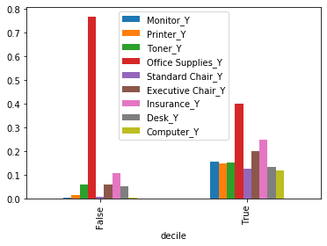
Office Supply product feature proved to be the most important product feature when purchased for decile 10

Slide 8
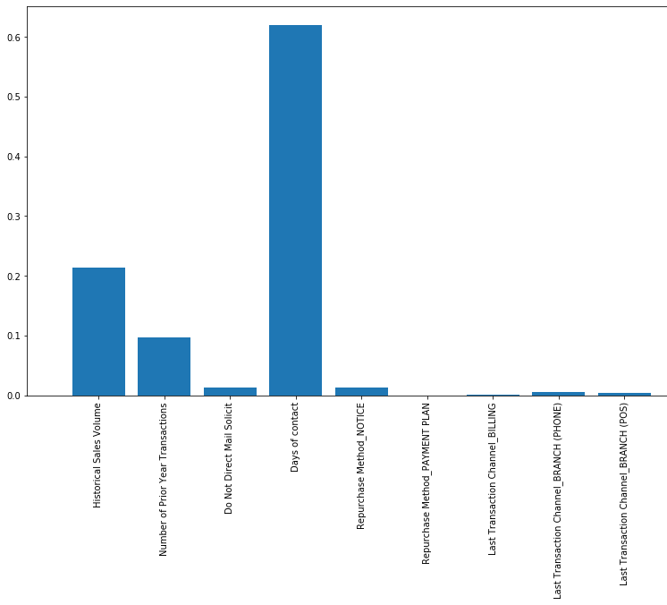
Features Importance
Days of contact a feature that was engineered seems to be a very important feature in regards on the purchasing of office supplies
Historical Sales Volume and Number of Prior Year Transaction also seem to be significant features

Slide 9
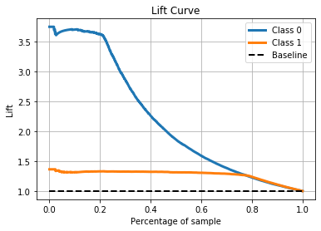
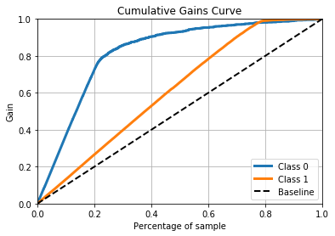
Data Analysis: Lift/Gains chart for validation set
Class 0 – N purchase not made
Class 0 – Y made purchase
Our model seems to perform the best at 20 percent of the sample. Then it decreases in performance. It seems that 20 percent of the sample will generate the most profit.

Slide 10
Decile cont’d
profit
decile
1 | -46.696058
2 | -46.197632
3 | -45.943836
4 | -45.638984
5 | -45.055907
6 | -43.894685
7 | -41.046388
8 | -23.482792
9 | -1.110143
10 | 201.104231

Slide 11

Gains generated: E(Profit)=.22$×$Prob(Sale)$×$Est(Transaction Size)-$8.40 $×$Prob(Sale)-$45.65
1st column – decile rankings(from least profitable to most profitable)
2nd column-sum predicted money or transaction size (calculated using gradient boosting regression)
3rd/4th - max/min probability of responding to campaing(calculated using gradient boosting classification)
5th – sum profit(calculated using Expected profit formula given)
6th-customer size within decile
predict_money | probability |  | profit | Customer size
 | sum | max | min | sum
decile
1 | -1.244295e+04 | 0.926837 | 0.022102 | -37917.198849 | 812
2 | -1.842791e+03 | 0.270211 | 0.011989 | -39960.952025 | 865
3 | -1.804781e+03 | 0.575532 | 0.008482 | -34320.045828 | 747
4 | 3.260069e+04 | 0.247570 | 0.008388 | -36876.299222 | 808
5 | 6.629830e+04 | 0.366684 | 0.012703 | -36405.172911 | 808
6 | 1.004297e+05 | 0.359687 | 0.021031 | -35423.010503 | 807
7 | 1.645224e+05 | 0.620699 | 0.028936 | -33165.481643 | 808
8 | 2.149443e+05 | 0.959483 | 0.043360 | -19114.992563 | 814
9 | 2.704495e+05 | 0.917030 | 0.127364 | -890.334520 | 802
10 | 1.186203e+06 | 0.991340 | 0.135302 | 162492.218890 | 808

Slide 12
Findings
It seems that from the table and lift.gains chart decile 10 is the only bracket of customers that will generate profit.
With the possibility of decile 9 also being profitable because of the low negative number value of -1.10 that occurred with the decile.
I believe that decile 10 is customer brackets that the company should focus the most on in future campaign sales.
Decile 9 is worth considering it might be the only other profitable customer bracket if we had a better model performance. It’s possible that their might be a loss but it is worth the risk in my opinion.

Slide 13
Recommendation
Decile 10 generates the most profit and is the only positive return. So the company should focus its attention to customers falling within decile 10
Decile 9 seems like a possible profitable bracket if we had a better model but we are unsure due to the limitations of our model. It is worth considering, but there is a potential risk within decile 9. The company could target decile 9 with precaution.
The company should provide more information such as about the customer, office supplies feature, and the period of time. In order to build a better model to improve performance.
Company should focus on customers that purchases office supplies because it is likely indicator that they belong in decile 10 thus they are likely to make profit.
Features the company should focus on more Length of membership/Days of Contact, historical sales volume, and number of prior year transaction
The period of membership and days of contact of customers is an important feature, along with historical sales volume and number of prior year transaction however more information is needed to make better judgement. The company should focus on these features more important feature, historical sales volume, and number of prior year transaction

